Slide 1
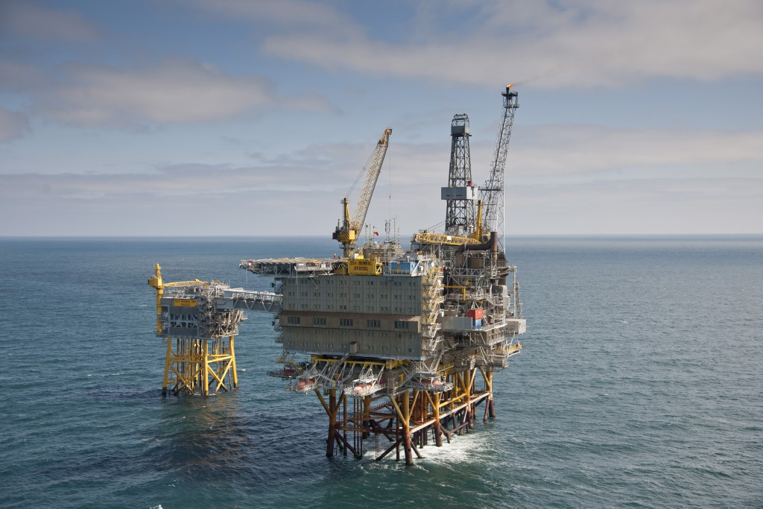
CE 410 Civil Engineering Design Multi-Purpose Offshore Platform»

Slide 2
OUTLINE
Introduction to Multi-Purpose Offshore Platform
Types of Offshore Platform
Usage of energy and water
Wind and wave studies
Structural analysis of offshore platforms

Slide 3
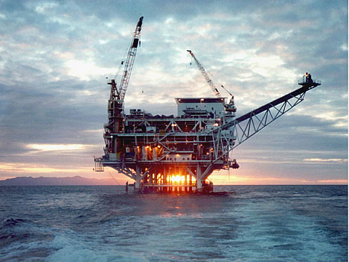
What is Offshore Platforms

Slide 4
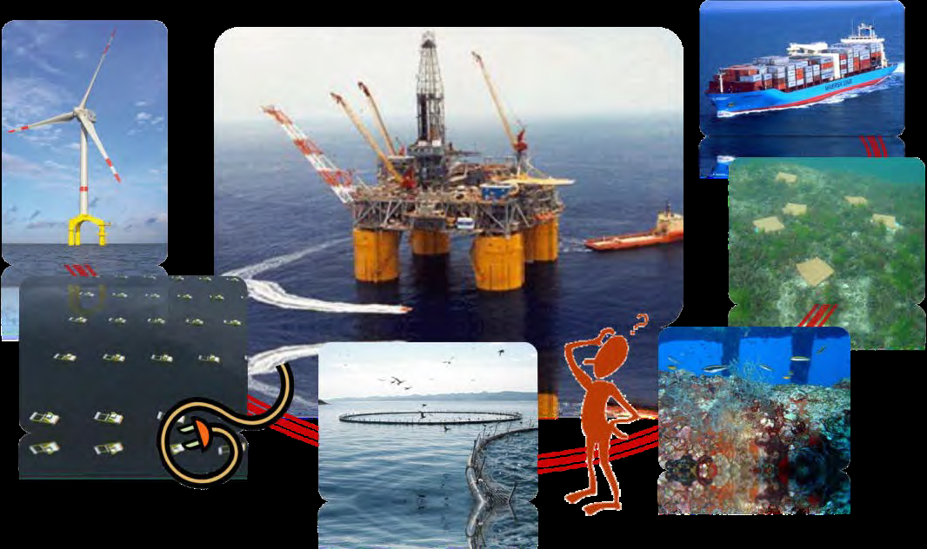
SHEME OF THE CONCEPT

Slide 5
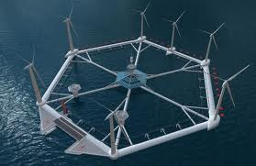
ENERGY FROM OFFSHORE

Slide 6
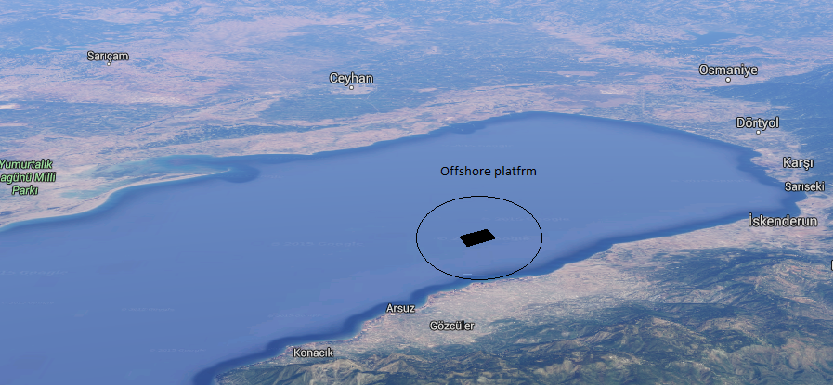
OUR PROJECT
Location
Type of the offshore
Aim of the project
How provide energy

Slide 7
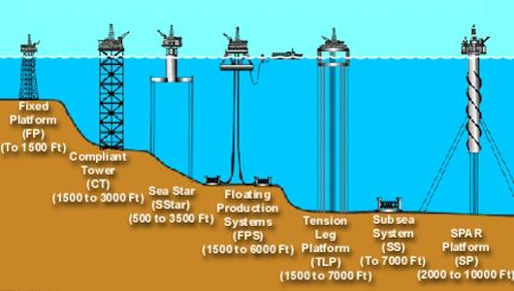
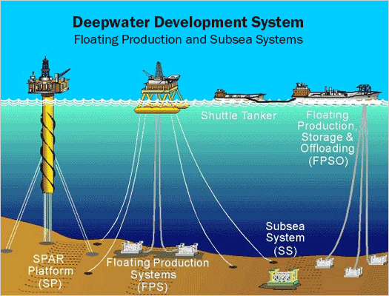
Types of Offshore Platforms
Offshore platforms can be categorized in two types:
Fixed Floater

Slide 8
FIXED OFFSHORE PLATFORMS
Jacketed Platform
Compliant Tower
Concrete Gravity Structures

Slide 9
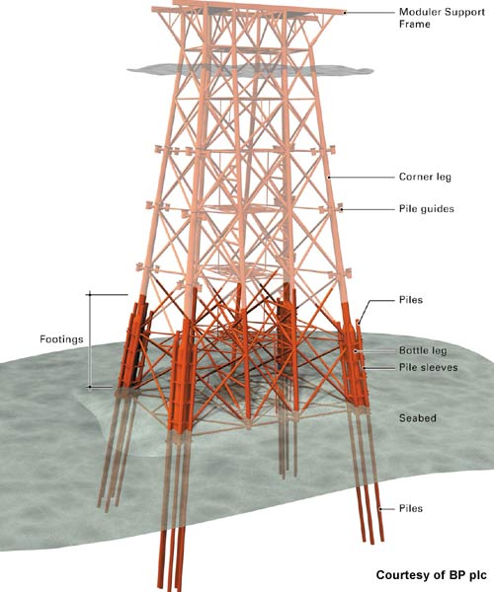
Jacketed Platform
95% of offshore platforms around the world are jacketed structures
The piles are contained inside the legs of a jacket structure serving as bracing for the piles against lateral load underwater.

Slide 10
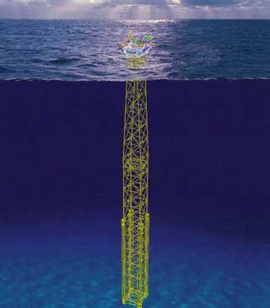
Compliant Tower
Narrow and flexible framed structures are supported by piled foundations.

Slide 11
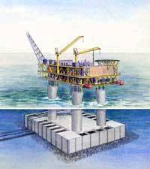
Concrete Gravity Structures
Fixed-bottom structures made from concrete
Heavy and remain in place on the bed without the need for piles
Advantage – less maintenance

Slide 12
FLOATER OFFSHORE PLATFORMS
Tension Leg Platforms
Semi Sub Platform
Spar
Ship Shaped Vessel

Slide 13
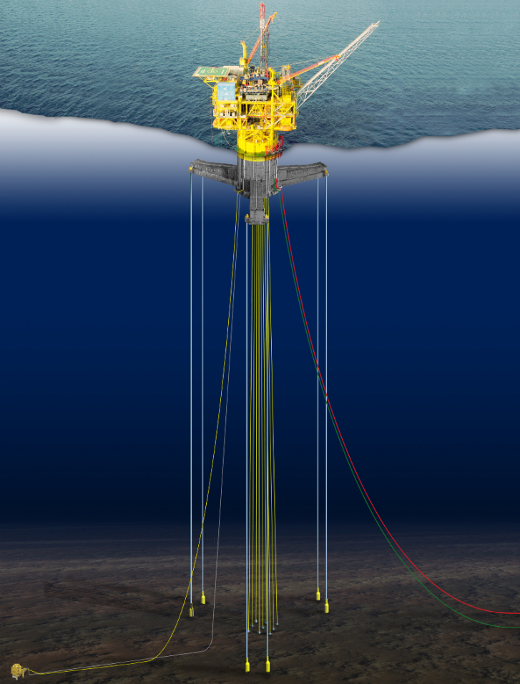
Tension Leg Platforms
Tied down to seabed by vertical steel tubes.
Rigidity in vertical direction , flexibility in horizontal direction.

Slide 14
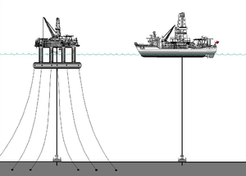
SemiSub Platform
Held in place by anchors connected to a catenary mooring system
Used for ultra deep water

Slide 15
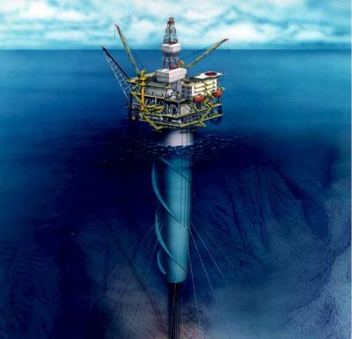
Spar Platform
Used in ultra deep water
Consists of a large diameter single vertical cylinder supporting deck
Deep draft of spars makes them less affected by wind ,wave and currents

Slide 16
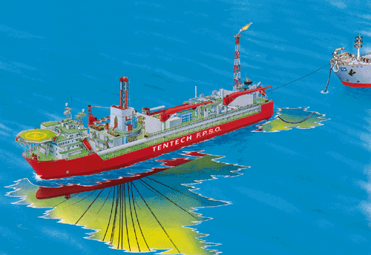
Ship Shaped Vessel Platform
Have oil storage capability
Used when building fixed platform is economically not feasible

Slide 17
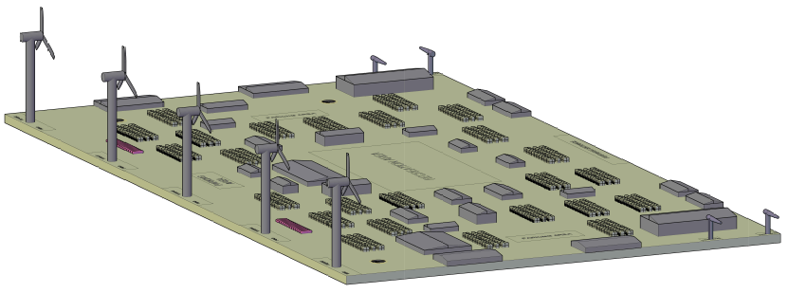
Functional Analyses of Platform
No electricity
No drinking water
No sewage

Slide 18
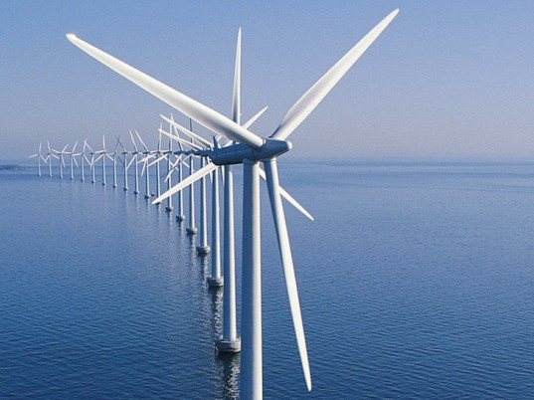
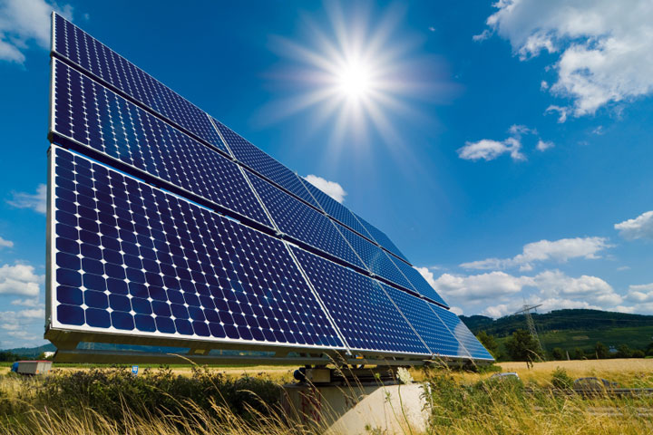
1. Electricity Production
Wind Turbine
Solar Energy

Slide 19
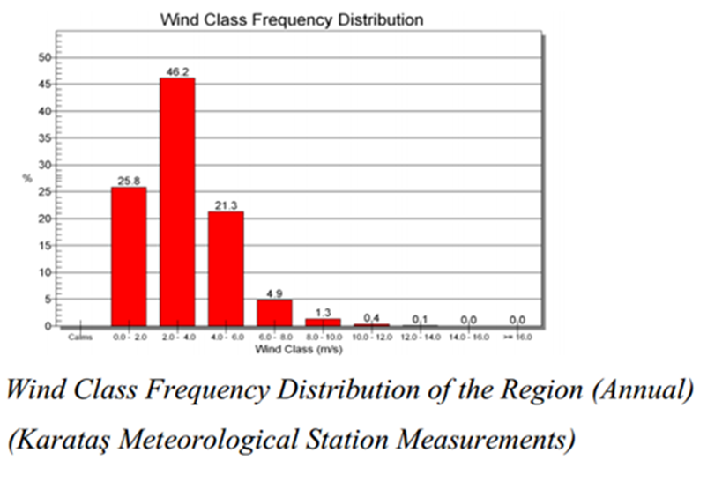
Wind Turbine
We need at least 5.4 m/sec wind for economic production.
Long Term Wind Statistics
Electricity consumption per person in year(kwh) | # of people | Total electiricty necessity (kwh) | Turbine capacity in year(kwh) | # of Required Turbine
3.310 | 10.000 | 33.100.000 | 8.760.000 | 4

Slide 20
Solar Energy
Power of a panel | # of panel | Total electiricty Production in year(kwh)
51 W | 75.000 | 7.000.000
51 W x 5 h x 365day x 75.000 = 7.000.000 kWh

Slide 21
2. Drinking Water Production
Water consumption per person in day (m^3) | # of people | Total water consumption (m^3) | Production capacity in day (m^3) | # of Required drinking water treatment plant
0,25 | 10.000 | 2500 | 5000 | 1

Slide 22
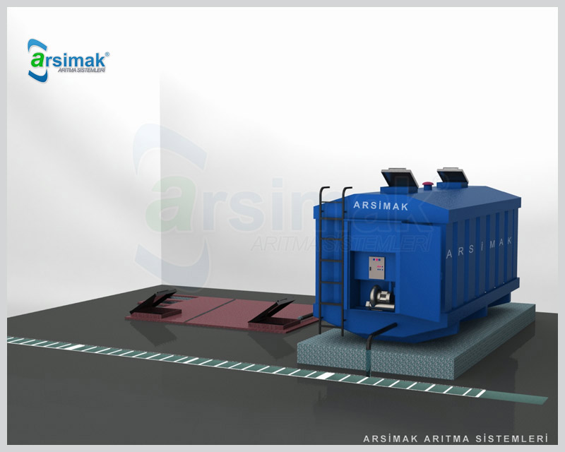
3. Sewage
Land Based Sewage Treatment system is used in this project
This system is used for 350 people.
10000/350 = 28,5
30 system is required for the platform.

Slide 23
Wind and Wave Climate Studies at İskenderun Bay
Karataş and Yumurtalık meteorological stations
Wind statistics
Wave transformation

Slide 24
Wind Statistics
Hourly average wind velocities(between 1985-2010
Graphics and wind roses

Slide 25
Results from Karataş Region
Long term wind statistics with 2m/sec intervals
Wind class frequency histograms
Annual statistics

Slide 26
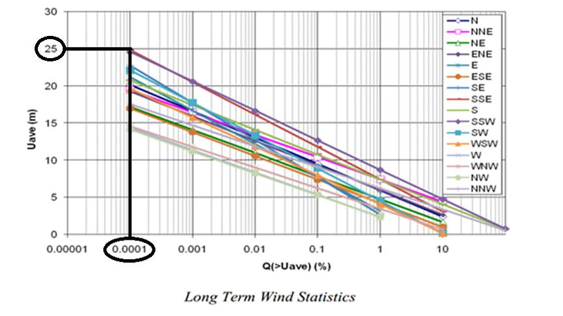
Results from Karataş Region

Slide 27
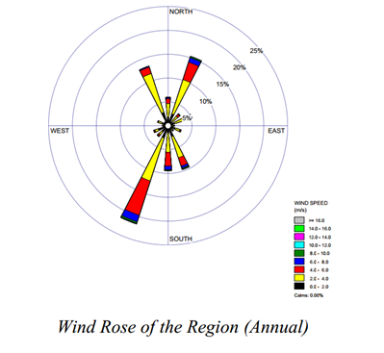
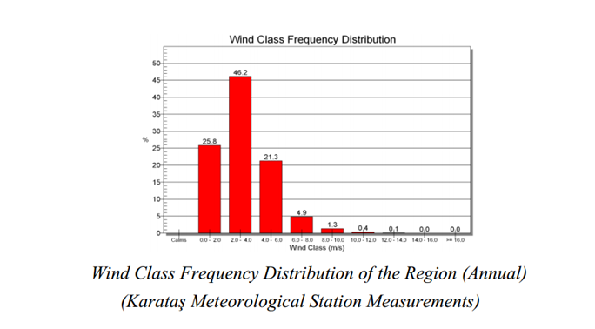
Results from Karataş Region

Slide 28
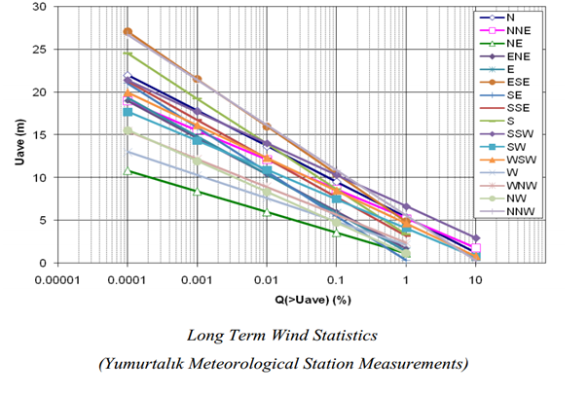
Results from Yumurtalık Region

Slide 29
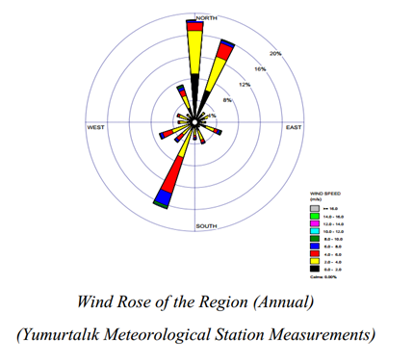
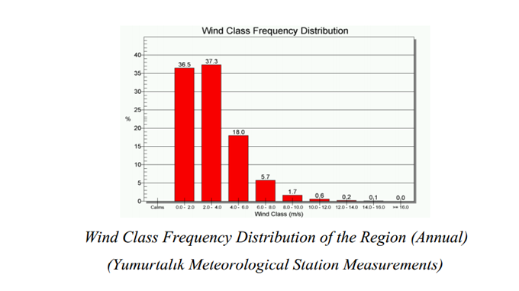
Results from Yumurtalık Region

Slide 30
Discussion of Wind Statistics
Karataş: SSW – SSE sector
Yumurtalık: SW – W sector
Dominant wind direction: SSW

Slide 31
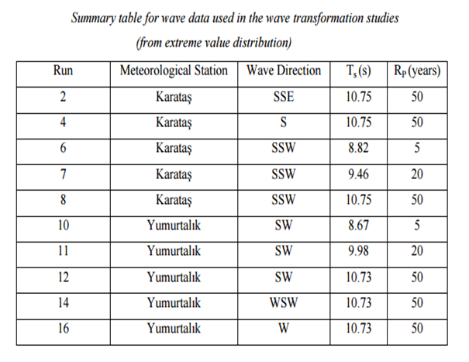
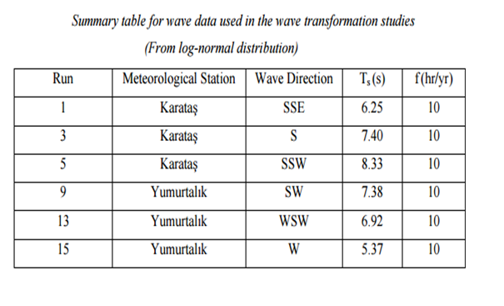
Wave Data Used in the Study

Slide 32
Wave climate study
Wave transformation runs
Wave heights at;
10 m water depth
deep water

Slide 33
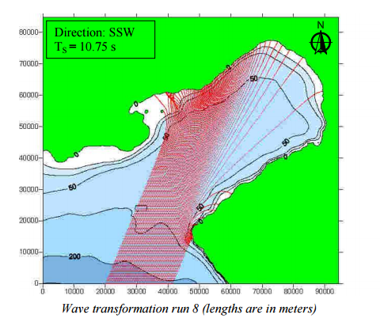
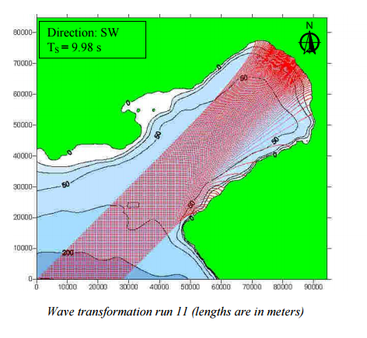
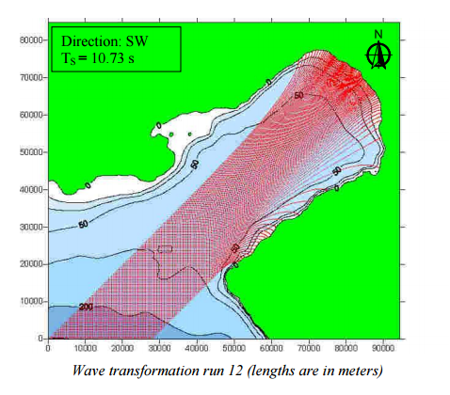
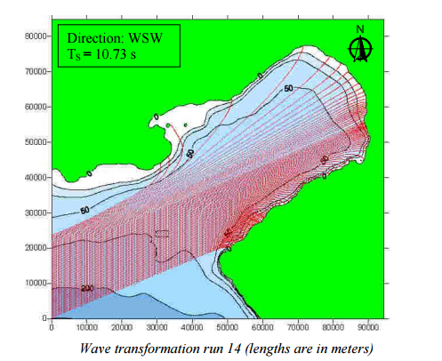
Wave Transformation Runs

Slide 34
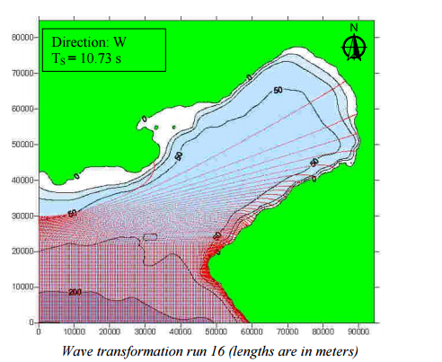
Wave Transformation Runs

Slide 35
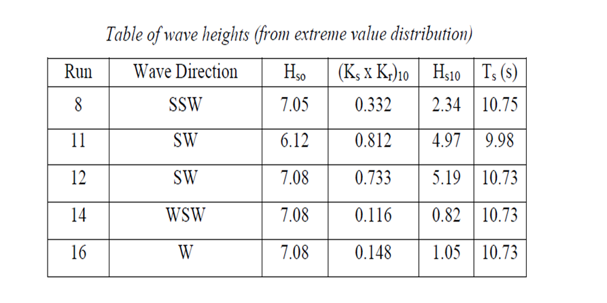
Largest Wave Heigths

Slide 36
Discussion of Wave Transformation
SSW direction have the highest wave heights
7.05m with T_{s} =10.75 s
SW, WSW & W are also effective directions

Slide 37
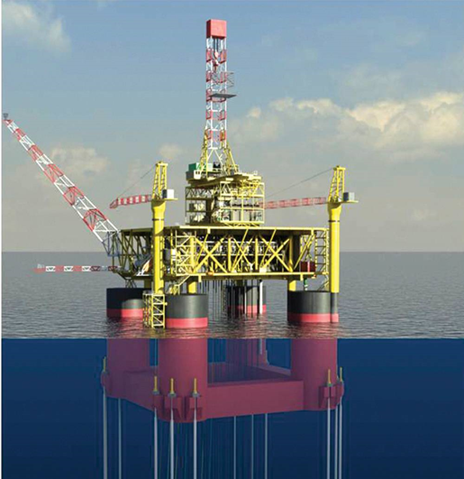
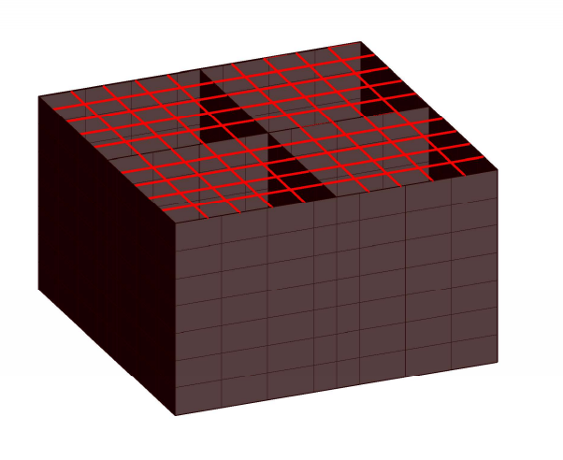
Platform size = 960x550 m Schematic illustration of 25X25 m block W_{structures} +W_{platform} < Fb

Slide 38
Steel structure weight is taken 50kg/m² in houses Steel structure weight is taken 100kg/m² in hospitals and schools Steel structure weight is taken 90kg/m² in other buildings Steel structure weight is taken 190kg/m² in hangars

Slide 39
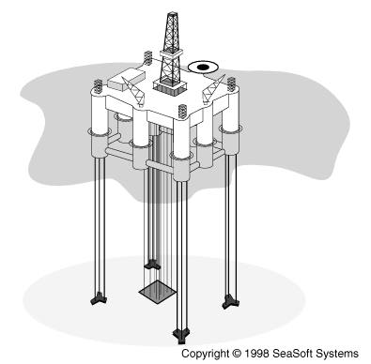
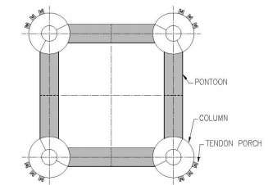

Slide 40
Advantages of Composite Carbon Fiber Tendons
Improved Fatigue Resistance
High Corrosion Resistance
High Tensile Strength
Less Weight

Slide 41
 | Composite carbon fiber strand | Steel Tendon
Cost ($/m) | 1640-2300 | 985-1300
Weight (kg/m) | 9.82 | 297.6
Installation Cost (kg/m) | 1640-3280 | 3280-4900

Slide 42
THANK YOU for LISTENING ANY QUESTIONS?

Slide 43
REFERENCES
Population data of Turkey (n.d.). Retrieved from: http://www.tuik.gov.tr/UstMenu.do?metod=temelist
S. S. Wang,D. W. Fitting Composite Materials for Offshore Operations
Electricity Consumption per person in year (n.d). Retrieved from: http://www.tuik.gov.tr/PreTablo.do?alt_id=1029
http://www.globalsecurity.org/military/systems/ship/platform-tension-leg.html
Richard D'Souza, Rajiv Aggarwal and Shilatidya Basu Granherne, Houstan, Texas The Tension Leg Platform – A Retrospective

